Slide 1
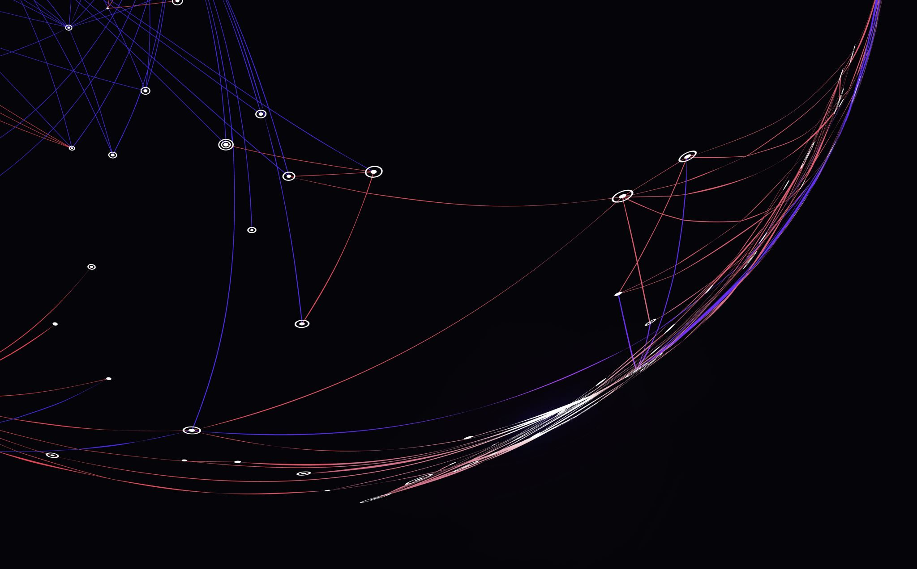
SimplyOnline
Simple way to connect

Slide 2


Agenda
Problem description
Acceptance Criteria
User Stories
Sprint 3 backlog and test cases
Team Metrics
Application Screenshots

Slide 3

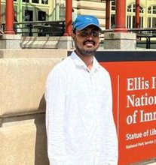
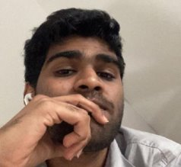

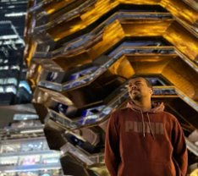
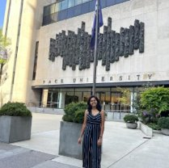
TEAM MEMBERS
Ajay Kumar
Full Stack Developer
Amarendra Reddy
Developer
Pruthvi Raj Reddy
Database Administrator
Mounik
Developer
Sreeja Reddy
Quality Analyst
Ravi Teja Reddy
Developer

Slide 4
Improvements from Professor’s feedback
Users Stories are improved and created with tables.
Sprint backlogs are improved.
Added project demo as video.

Slide 5
Project Description
Simply online is a web application that aims to simplify the process of online classes. This application allows lecturers to create virtual rooms and share the room id with their students for seamless connectivity. Using webRTC technology, simply online allows group video-sharing features and screen-sharing capabilities. This application allows lecturers to easily take attendance with just a click of a button. This platform automatically marks attendance, eliminating the need for manual tracking. Overall, simply online offers a comprehensive and user-friendly solution for educators and students to enhance their online learning experience

Slide 6
Team Working Agreement
Participation:
All the team members are expected to involve in project discussions and attend the meetings promptly. Absence during multiple meetings will affect the team’s performance and efficiency.
The team member can discuss beforehand with the team leader if he/she is going to miss the meeting or make it up for it before the next meeting is scheduled.
Communication:
The team will communicate with each other using WhatsApp group and meetings will be scheduled on Zoom.
Jira software will be used to track the assigned tasks. For any dependency on another task, mention it in the task comments.
Task management, bugs, sprint planning, and meeting minutes will be tracked in Jira.
To share the final deliverables, Google docs will be used where all the team members can edit the document.
Work Division:
The entire project work should be divided into equal parts, and equal responsibilities should be given to all the team members.
Each team member should complete their division of work before the deadline. If they are unable to complete the work on time, that hinders the performance of the entire team. If in case a team member is facing trouble and issues at some point, they can share it with others so that they can help each other and complete the work before the deadline.
Meetings:
All the team members will meet on zoom virtually every Tuesday and Friday. All the team members must be present, as attendance is mandatory unless there is an exceptional case.
The team leader would be responsible for sending meeting details and conducting the meeting.
A meeting track or meeting minutes report would be listed after every meeting to keep track of the project and its progress.
Every team member is expected to come up with ideas, participate in the discussion, and give an update on their progress for their part of the work.

Slide 7
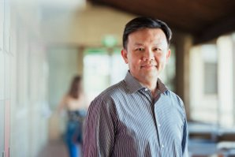
Persona
Name: Professor James​
Age: 45​
Occupation: University Professor​
Profile:
James is a tenured professor in the Computer Science department at a large university. He teaches both undergraduate and graduate-level courses and conducts research in his field. Due to the COVID-19 pandemic, his classes have been moved online, and he uses various platforms to deliver lectures, holds office hours, and communicate with his students. He lives with his spouse and two children, who are also attending school virtually.
Goals and Motivations:
Deliver high-quality lectures and course material to his students Engage his students and create a dynamic and interactive virtual classroom environment.
Ensure that his students are keeping up with the coursework and meeting their learning objectives.
Provide effective feedback and support to his students.

Slide 8

Persona
Name: Sarah
Age: 24
Occupation: College student
Profile:
Sarah is a full-time student pursuing a degree in psychology. Due to the COVID-19 pandemic, her classes have been moved online, and she uses Zoom to attend lectures, participate in group discussions, and communicate with her professors and classmates.
She lives in a small apartment with roommates and shares a room with one of them.
She has a busy schedule and often has to balance her coursework with a part-time job and other responsibilities.
Goals and Motivations:
Attend all her classes and be an active participant in class discussions Stay organized and manage her time effectively to meet assignment deadlines.
Have a reliable and user-friendly platform for attending virtual classes. Connect with her professors and classmates, and build a community within her course

Slide 9

Persona
Name: Ishika
Age: 27
Occupation: Elementary school teacher
Profile:
Ishika is a dedicated elementary school teacher who loves working with children. She has been teaching for three years and is always looking for ways to improve her classroom management and student engagement. Ishika is originally from India but moved to the US with her family when she was a child. She is fluent in English and Hindi and enjoys cooking traditional Indian dishes in her free time
Goals and Motivations:
Ishika is a dedicated elementary school teacher who loves working with children. She has been teaching for three years and is always looking for ways to improve her classroom management and student engagement. Ishika is originally from India but moved to the US with her family when she was a child. She is fluent in English and Hindi and enjoys cooking traditional Indian dishes in her free time
Ishika’s main goal is to create a safe and engaging learning environment for her students. She wants to be able to take attendance quickly and efficiently so she can spend more time teaching and less time on administrative tasks. Sarah is also motivated by the opportunity to track student attendance and identify patterns that might indicate a need for additional support.

Slide 10
















Technologies

Slide 11
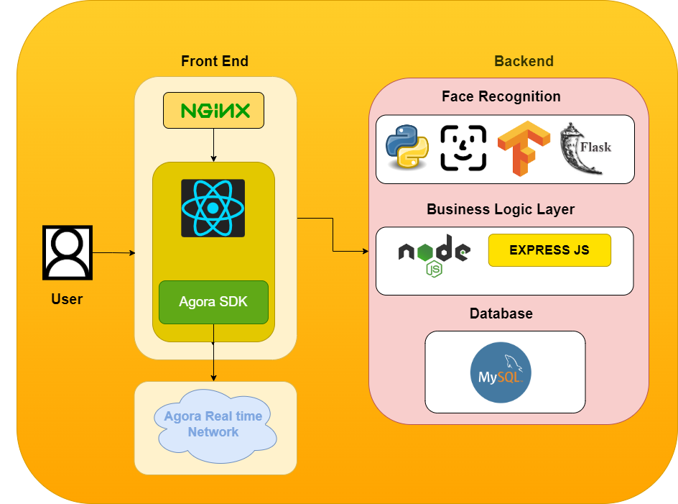
Architecture Diagram

Slide 12
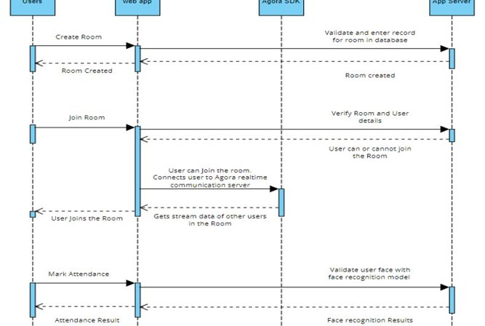
Sequence Diagram

Slide 13
MINIMUM VIABLE PRODUCT

Slide 14
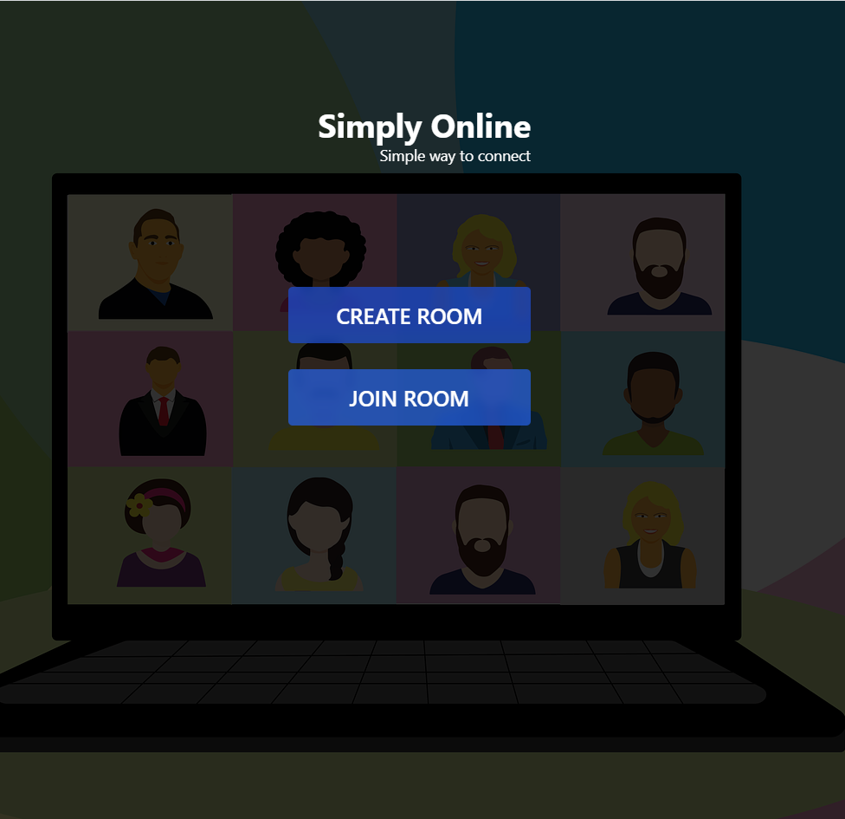
Home Page
Home page has a simple interface where users can create new room or join existing room.

Slide 15
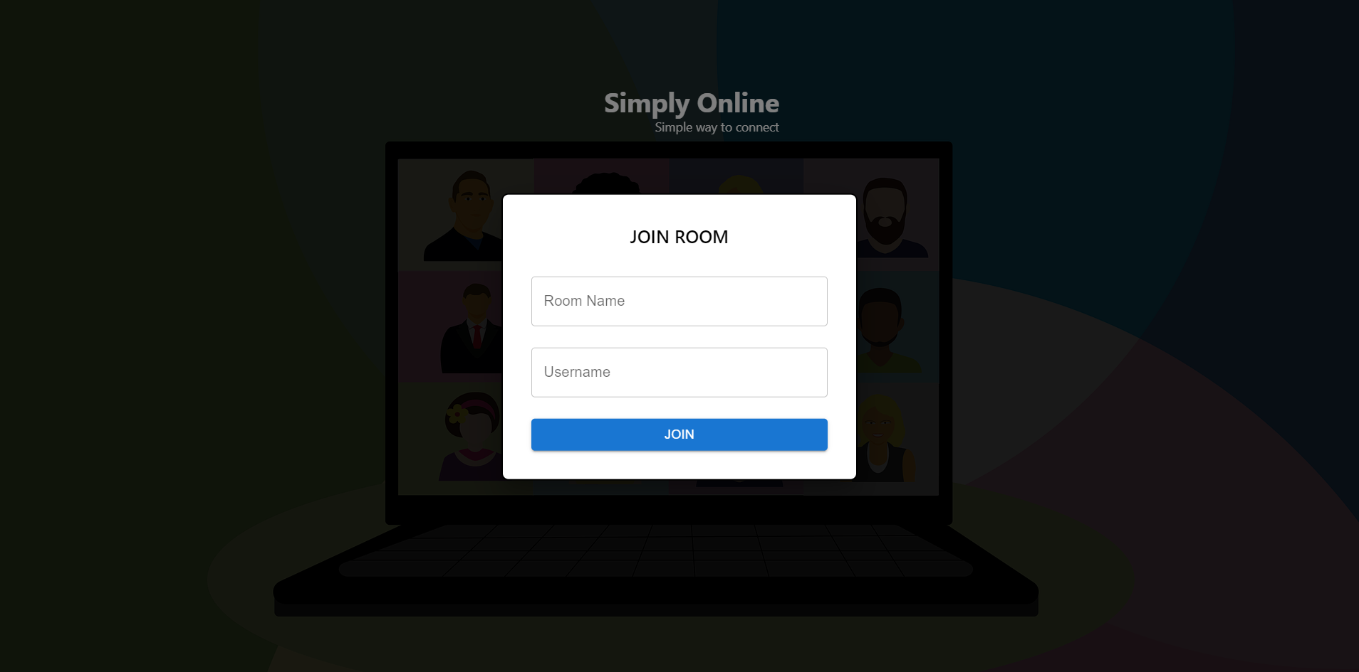
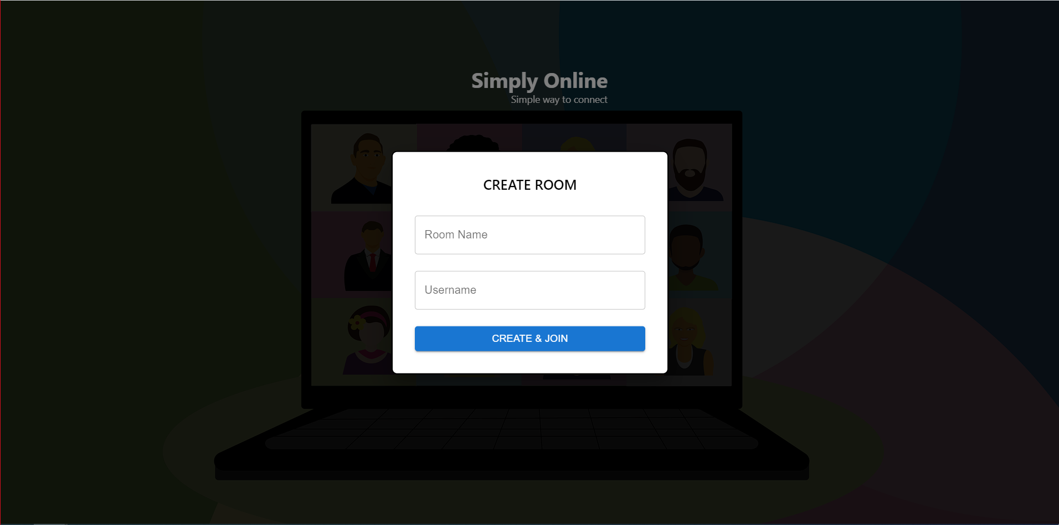
Create/Join Room
User can create or Join a room by providing Room Name and Username

Slide 16
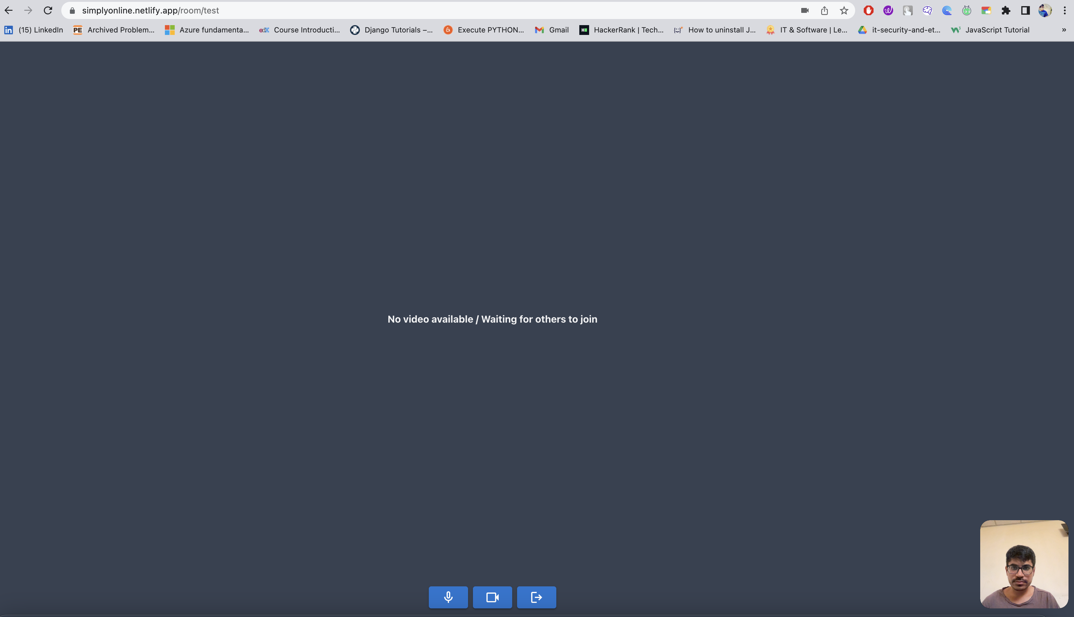
Room
Single user room interface after joining in the room.

Slide 17
Acceptance criteria
Scenario | Summary | Criteria
1. User should be able to create Online Classroom | As a user Given I'm on the Home page When I click on "Create Room" Button Then I should see popup asking for "Room Name" and "Username" When I enter "Room name" and "Username" And I click on "Create & Join" button Then a room should be created and I should enter the room | User Experience: I Should be redirected to video conference screen.
2. User should be able to join an existing Room | As a user Given I'm on the Home Page When I click on "Join Room" Button Then I should see popup asking for "Room Name" and "Username" When I enter Room Name and Username And I click on "Join" button Then I should join the room | User Experience: I should be redirected to the video conference screen

Slide 18
Acceptance criteria
Scenario | Summary | Criteria
3. User should have control to turn his mic on or off | As a user Given I'm on the "Room Page" And there are other users also in the room When I click on "Mic" Icon Then My mic should be disabled When I click on "Mic" Icon Then My mic should be enabled | Changes should reflect to other users in the room, if the audio is disabled and enabled as expected.
4. User should have control to turn his video on or off | As a user Given I'm on the "Room Page" And there are other users also in the room When I click on "Video" Icon Then My video should be disabled When I click on "Video" Icon Then My video should be enabled again | Changes should reflect to other users in the room, if the video is disabled and enabled as expected.

Slide 19
Acceptance criteria
Scenario | Summary | Criteria
5. User should exit from the room | As a user Given I'm on the "Room Page" When I click on "Exit" Icon Then I should exit from the room And redirected to home page | Changes should reflect to other users in the room, if the audio is disabled and enabled as expected.
6. Verify face recognition | As a user Given I'm on the "Face Recognition" Page When I click on "Capture" Button Then My picture should be clicked And "Retake" and "Verify" buttons should be visible When I click on "Verify" button Then the image should be verified and result should be printed | Accuracy: Face recognition should be accurate and work as expected User Interface: Result should be printed below the verify button

Slide 20
Test Cases
Unit to test | Scenario | Expected Result
Create Room | Create room | Room should be created and user should be redirected to Room page
Join Room | Join Existing Room with users already joined | User should be joined into the room and see other users in the room
Mic | Mic enable and disable | Mic should be enabled or disabled when user clicks on mic icon
Video | Video enable and disable | Video should be enabled or disabled when user clicks on video icon
Load testing | User load testing with more than 10 users | Join the same room with 10 users and test the performance
Face Recognition | Test face recognition model | Verify model with test images from UI
UI responsiveness | Test user responsiveness | UI should be interactive for all devices
User session | User name should be saved if user enters it once | When username is entered while entering one room, name should be saved and should be auto filled next time

Slide 21
Product Backlog
Summary | Issue key | Status | Priority
Create UX & UI screen for group calling | SIM-14 | Done | Medium
Test the maximum users that can be connected to one group call using peer to peer architecture | SIM-15 | Done | Medium
Create Face recognition model using tensor flow | SIM-16 | Done | Medium
Analysis and implementation of facial recognition model using tensor flow | SIM-18 | Done | Medium
Connect to Agora RTC Server to enable group video calling | SIM-25 | Done | Medium
create tables and stored procedures to save and retrieve data | SIM-27 | In Progress | Medium
ux changes for better interactivity | SIM-31 | Done | Medium
Implement video conference ui using agora react component library | SIM-32 | Done | Medium
Face recognition implementation using deepface | SIM-33 | Done | Medium
Research on deepface | SIM-34 | Done | Medium
Create a web api using flask to connect to face recognition code | SIM-35 | Done | Medium
Implement face recognition in ui | SIM-36 | Done | Medium

Slide 22
Sprint Backlog
Summary | Issue key | Status
Implement UI to mark attendance | SIM-17 | To Do
Test facial recognition model | SIM-19 | In Progress
Enable attendance marking feature to room owners | SIM-20 | To Do
Enable screen sharing feature | SIM-21 | To Do
Test whole application and implementation of auto attendance system | SIM-22 | To Do
create tables and stored procedures to save and retrieve data | SIM-27 | In Progress
Technical paper and documentation | SIM-28 | To Do
Deployment Procedure | SIM-29 | To Do
Test of whole application functionality | SIM-30 | To Do

Slide 23

Retrospective
What went well:
Team completed all the stories that were planned for the sprint and able to deliver work that met the requirements. Team successfully encountered unexpected challenges or obstacles during the sprint.
What needs to improve:
Team needs to be effectively collaborated and communicate with each other to ensure that the work should on time.

Slide 24
Metrics

Slide 25
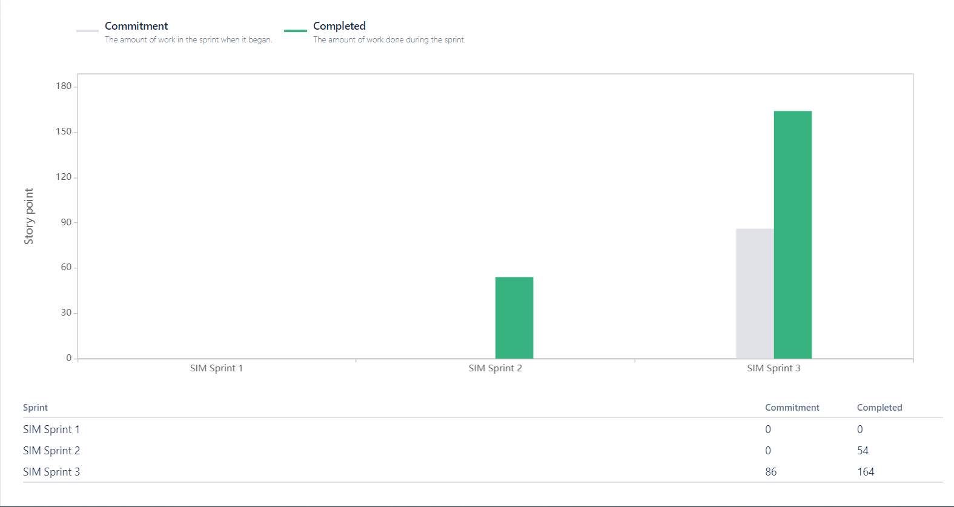
Velocity Report

Slide 26
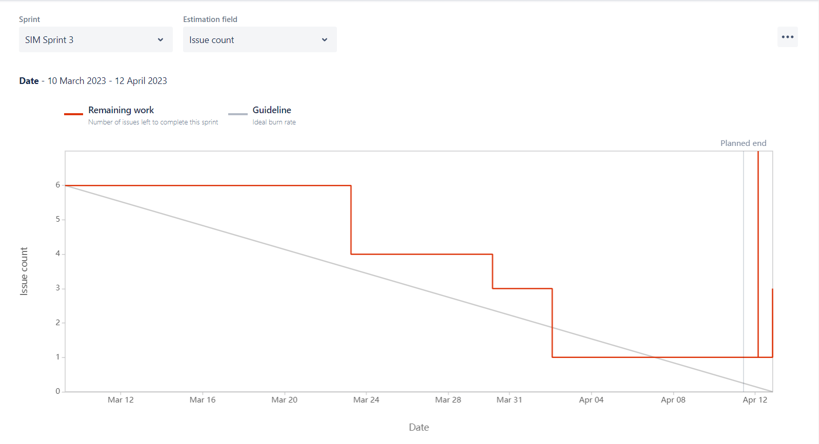
Sprint Burndown Chart

Slide 27
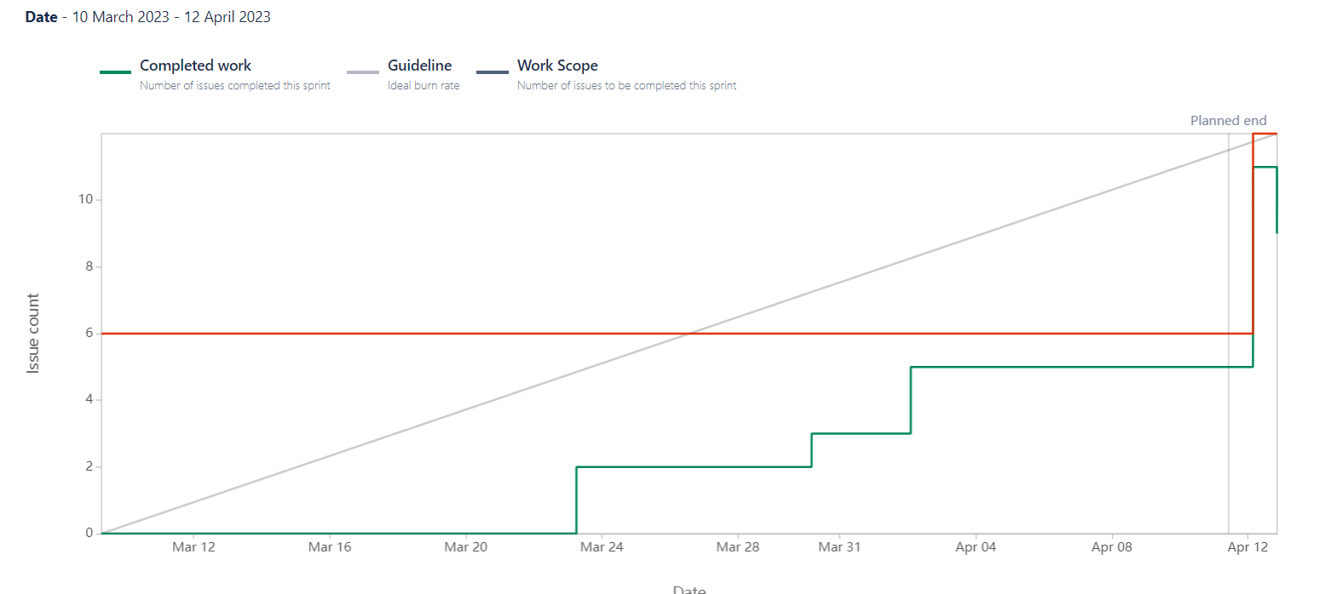
Burnup Report

Slide 28

Group call

Slide 29
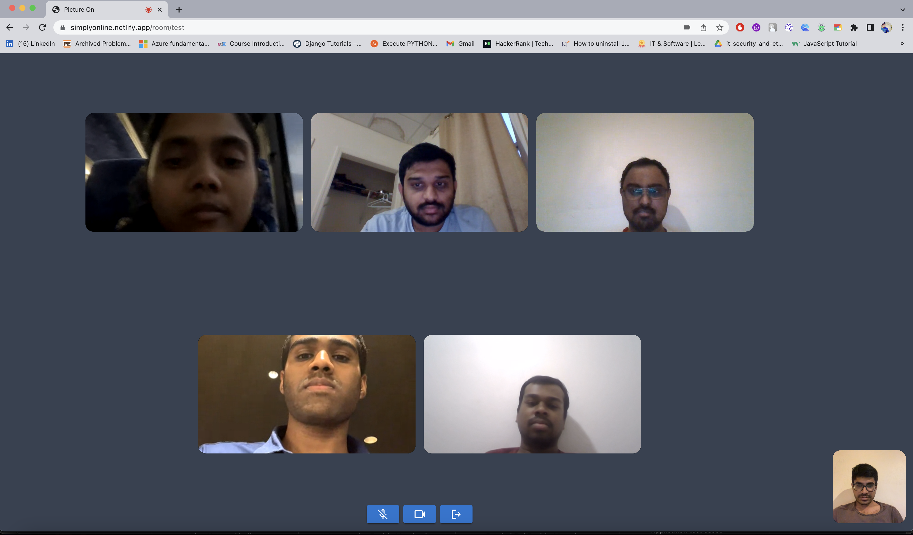

Slide 30
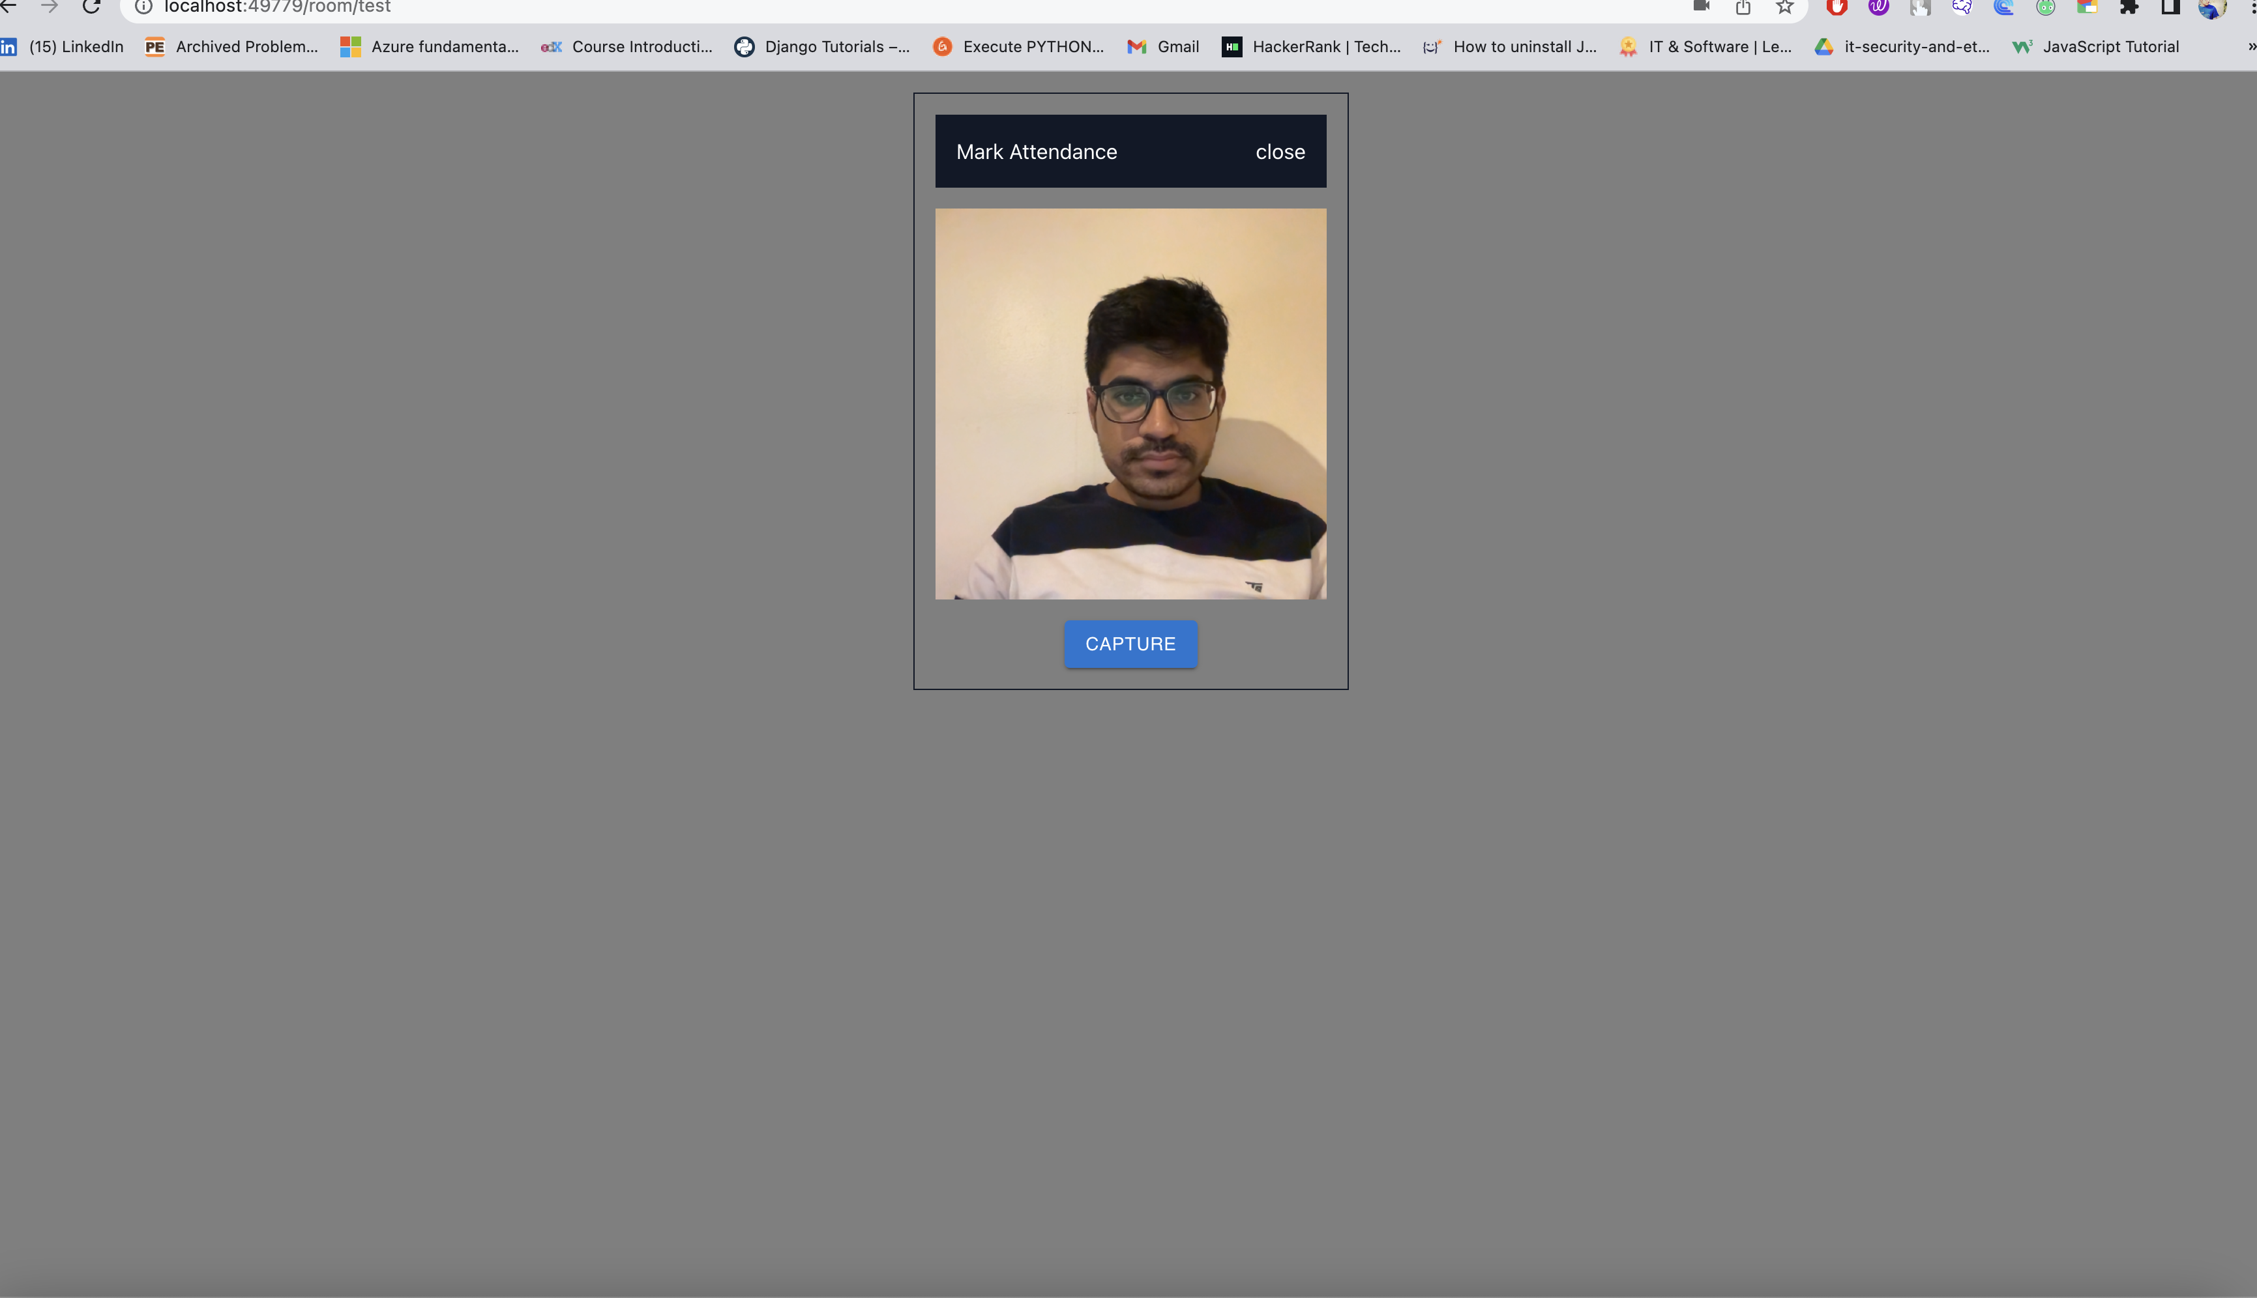
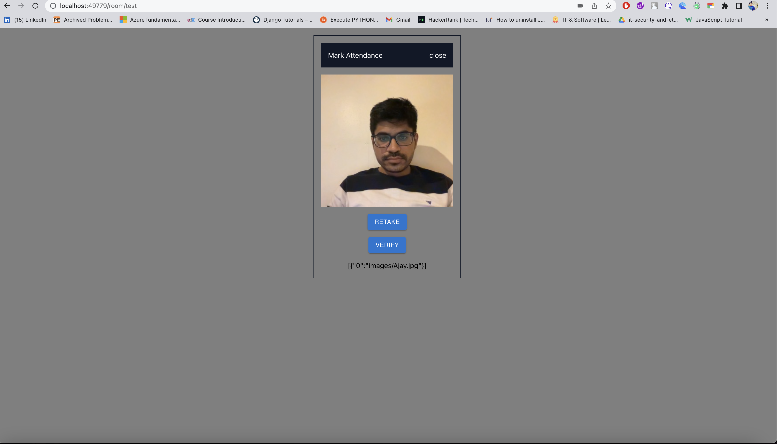
Mark Attendance/verify
This screen allows user to capture the photo and verify that it is the same user or not

Slide 31
Thank You

